Slide 1

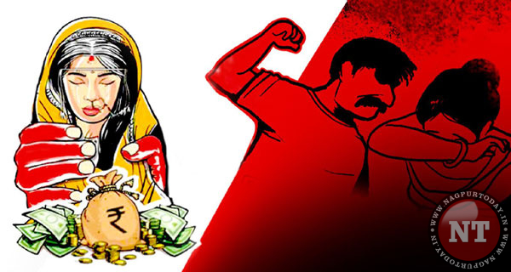
Dowry system
Is a social evil…..

Slide 2
‘dowry’ stands for…
D- donkeys
O-of the first order
W-who can’t stand on their own feet.
R-rely on their wivws riches
Y-yet shameless

Slide 3
introduction
Dowry is a social evil in india . We daily read in newspapers and watched in t.V. About dowry deaths . dowry spoils all pleasures of married life . it has taken a fearful form.

Slide 4
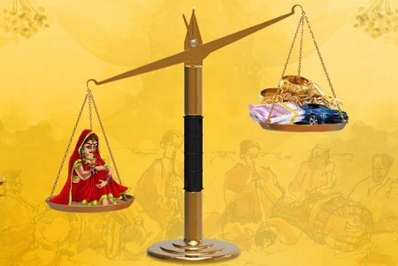
DOWRY MAY BE IN THE FORM OF:
Goods(clothing &jewellery)
Assets (livestock, land or cash)

Slide 5
Dowry system is a social evil in the society.
The evil has taken lives of Women from all straits of society.

Slide 6
Causes of DOwry system
Illiteracy
Greedy groom families demand it.
To build a reputation in society.
Ignorance of anti-dawry laws.

Slide 7
Effects of dowry system:
Dowry system has been observed to be strongly associated with the status of bride family and , if not provided , leads -
to family conflicts , violence and dowry deaths and burning the bride…

Slide 8
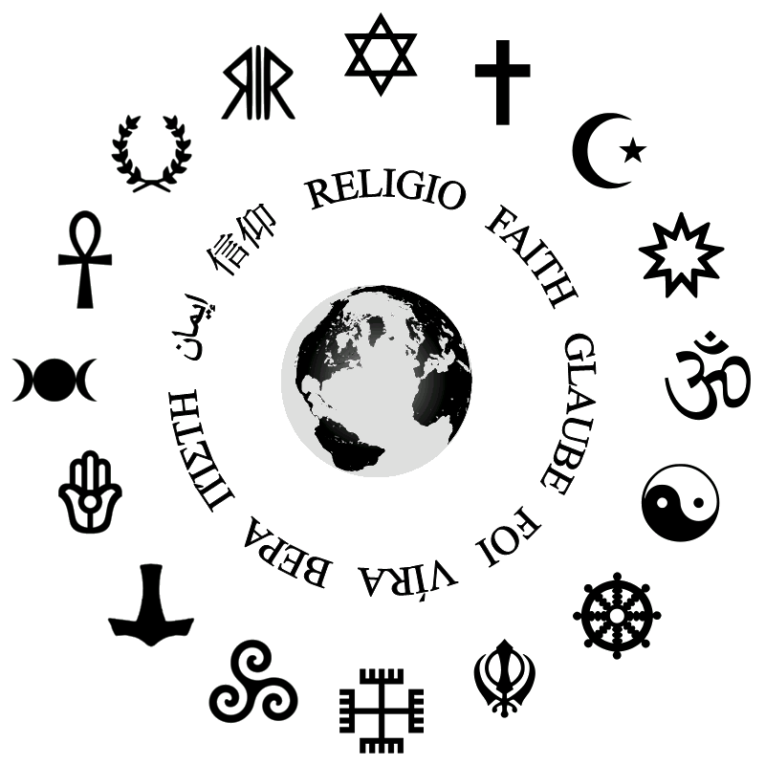
Factors that favours evil of dowry…
Religion and tradition
Educational status
Urban living…

Slide 9

In a democratic
country
Where are they
lacking their
rights….?

Slide 10
‘Where women are honoured there gods are pleased ;but where they are not honoured no scared rite yields rewards’.

Slide 11
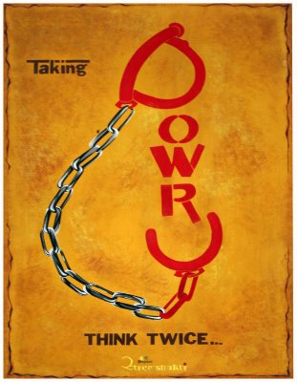

Slide 12
Thank you for watching

